Slide 1

FRAME ALIGNER VERIFICATION PLAN
Name: Daniel Izhak
ID: 315901892
Date : 15/11/24

Slide 2

INTRODUCTION
Design overview
A Frame Aligner is a component in communication systems, especially within data transmission protocols. Its primary function is to synchronize incoming data streams by detecting specific patterns within a sequence of data frames.

Slide 3
INTRODUCTION
Design overview
By identifying these patterns, the frame aligner ensures proper alignment of the data, which is essential for accurate data processing and integrity in downstream systems.

Slide 4
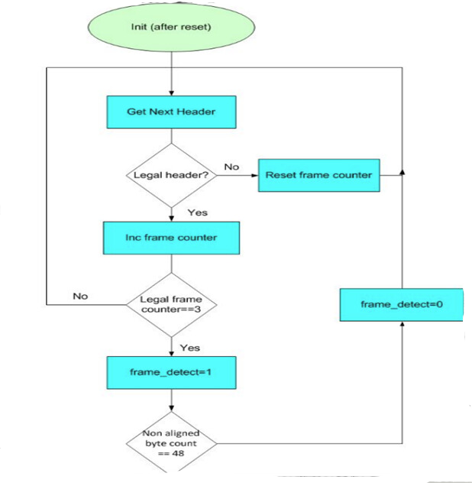
INTRODUCTION
Alignment Flow

Slide 5
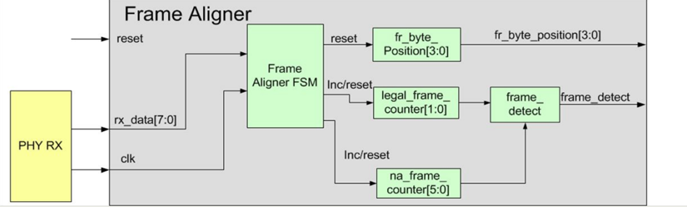
INTRODUCTION
Frame Aligner Block Diagram

Slide 6
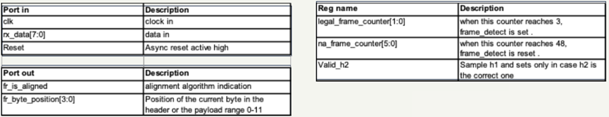
INTRODUCTION
Frame Aligner Block Diagram

Slide 7
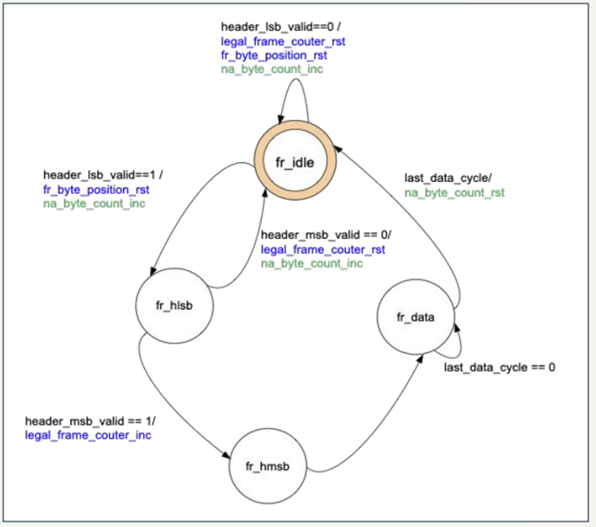
INTRODUCTION
FSM

Slide 8
INTRODUCTION
Goals of verification
This verification plan outlines the testing strategy for the Frame Aligner module, implemented in SystemVerilog, whose primary function is to detect frame boundaries within an incoming data stream and maintain frame alignment. The frame aligner accomplishes this by identifying specific header patterns.

Slide 9
VERIFICATION ENVIRONMENT
Simulation Environment
The simulation will be conducted using the system Verilog environment. A test bench will be created to simulate the module by feeding data into the registers and executing the operations.

Slide 10
VERIFICATION ENVIRONMENT
Simulation flow
The simulation flow defines the sequence of steps required to verify the functionality of the frame aligner module. Each step ensures that the module performs as expected under different conditions, confirming alignment accuracy, correct FSM transitions, and counter behavior

Slide 11
VERIFICATION ENVIRONMENT
Verification Components
DUT (Design Under Test): Frame Aligner Module
The core design under test is the frame aligner module. This module is responsible for detecting frame boundaries in the incoming data stream by identifying header patterns, handling valid and invalid frames, and transitioning through a defined FSM.
It maintains internal counters for valid (legal_frame_counter) and non-aligned (na_byte_counter) frames, and signals frame alignment with the frame_detect output.

Slide 12
VERIFICATION ENVIRONMENT
Verification Components
Driver
The driver is responsible for generating the necessary inputs to the DUT. It stimulates the DUT by providing the incoming data (rx_data), applying reset (reset), and controlling the clock (clk).
The driver will also trigger transitions in the FSM by sending header bytes and frame data at appropriate timings

Slide 13
VERIFICATION ENVIRONMENT
Verification Components
Monitors
The monitor observes the input signals fed into the DUT as well as the output signals. For the frame aligner module, the monitor will track inputs like rx_data and reset to ensure that the correct transitions are made within the FSM.

Slide 14
VERIFICATION ENVIRONMENT
Verification Components
Scoreboard
1. The scoreboard checks the correctness of the results by comparing the actual outputs with expected outputs for each frame alignment scenario.

Slide 15
VERIFICATION ENVIRONMENT
Verification Components
2. It checks the values of legal_frame_counter, na_byte_counter, and fr_byte_position to ensure they behave as expected based on the frame input pattern.

Slide 16
VERIFICATION ENVIRONMENT
Verification Components
3. The scoreboard should ensure that the FSM (Finite State Machine) transitions between the correct states. It should track transitions like:
a. From FR_IDLE to FR_HLSB upon detecting a valid header LSB.
b. From FR_HLSB to FR_HMSB upon detecting a valid header MSB.
c. Returning to FR_IDLE when the frame alignment is lost or reset.

Slide 17
VERIFICATION ENVIRONMENT
Verification Components
4. The scoreboard can maintain a model of the expected frame patterns based on the rx_data input:
a. When the header_lsb_valid and header_msb_valid signals are asserted, the scoreboard should expect the next data in the frame to match the pattern for valid frames.
b. If the expected frame data does not match the actual data, the scoreboard can flag the frame as invalid.

Slide 18
VERIFICATION ENVIRONMENT
Verification Components
Coverage
The coverage component tracks the functional coverage metrics during simulation to ensure that all aspects of the frame aligner design are sufficiently exercised.

Slide 19
VERIFICATION ENVIRONMENT
Verification Components
1. Functional Coverage includes checking that the frame aligner behaves correctly under all relevant conditions. This involves monitoring:
State Transitions
Header Detection

Slide 20
VERIFICATION ENVIRONMENT
Verification Components
State Transitions: Ensure all states of the FSM (FR_IDLE, FR_HLSB, FR_HMSB, FR_DATA) are covered, including transitions between states based on input signals.
Header Detection: Verify that the frame aligner correctly detects valid header patterns (8'haa and 8'h55) for both the LSB and MSB headers and moves to the appropriate state upon detection.

Slide 21
VERIFICATION ENVIRONMENT
Verification Components
2. Counter Conditions:
legal_frame_counter: Ensure it increments only when valid frames are detected and resets correctly upon reset or invalid header detection.
na_byte_counter: Ensure it increments during invalid frame patterns and resets correctly.
·fr_byte_position: Verify that it increments with each byte and resets upon frame misalignment or at the end of a frame.

Slide 22
VERIFICATION ENVIRONMENT
Verification Components
3. Frame Detect Signal: Verify that the frame_detect signal asserts when legal_frame_counter reaches the threshold (e.g., three valid frames) and deasserts when na_byte_counter reaches the maximum allowed value for non-aligned frames (e.g., 47).

Slide 23
VERIFICATION ENVIRONMENT
Verification Components
4. Coverage Data is collected through dedicated covergroups and coverpoints, which log the scenarios exercised during testing. This provides insight into the thoroughness of the testbench and reveals any untested parts of the frame aligner design. Coverage metrics include:
Header Pattern Coverage
State Transition Coverage

Slide 24
VERIFICATION ENVIRONMENT
Verification Components
Header Pattern Coverage: Log different header patterns (e.g., 8'haa followed by 8'haf, and 8'h55 followed by 8'hba) and ensure all combinations are tested.
State Transition Coverage: Track each transition between FSM states to verify that all transitions occur as expected.

Slide 25
BLOCK DIAGRAM
Test Plan
List of tests
Coverage | Expected Results | Test description | Feature | Test number
byte_position_track_cg | frame_detect asserts after with point start of fr_position =0 | Ensure the byte transition is valid | byte_position_tracking_cg | 1

Slide 26
List of tests
Coverage | Expected Results | Test description | Feature | Test number

Slide 27
List of tests
Coverage | Expected Results | Test description | Feature | Test number

Slide 28
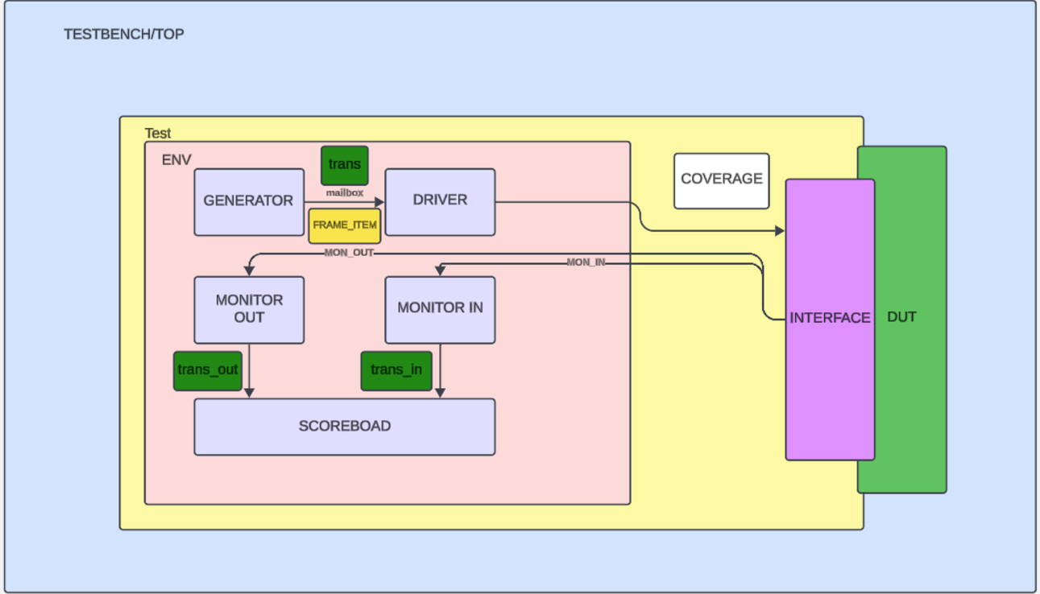
Block Diagram

Slide 29
THANK YOU

